Slide 1
Madison County School
District’s
School Related Personnel of the Year 2022-2023

Slide 2
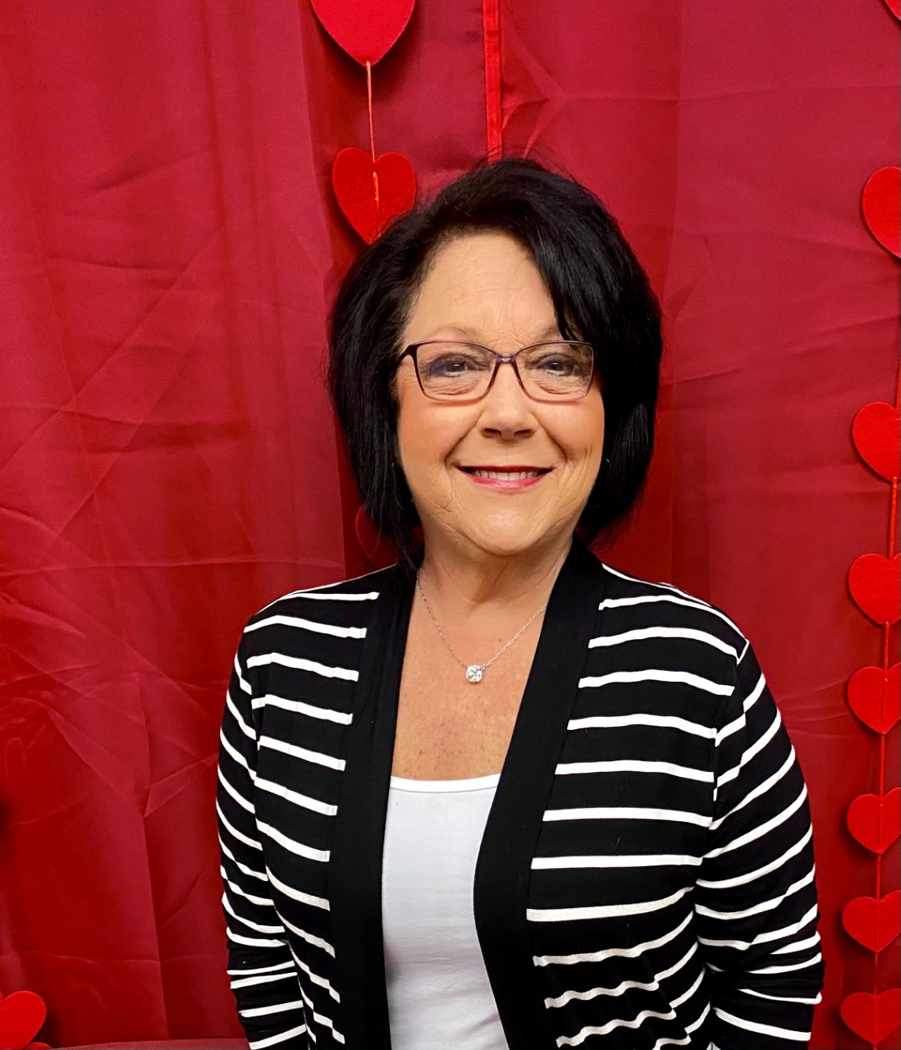
Ms. Sandra Fletcher
Madison County District Office

Slide 3
Mr. Roderick Williams
District Transportation

Slide 4
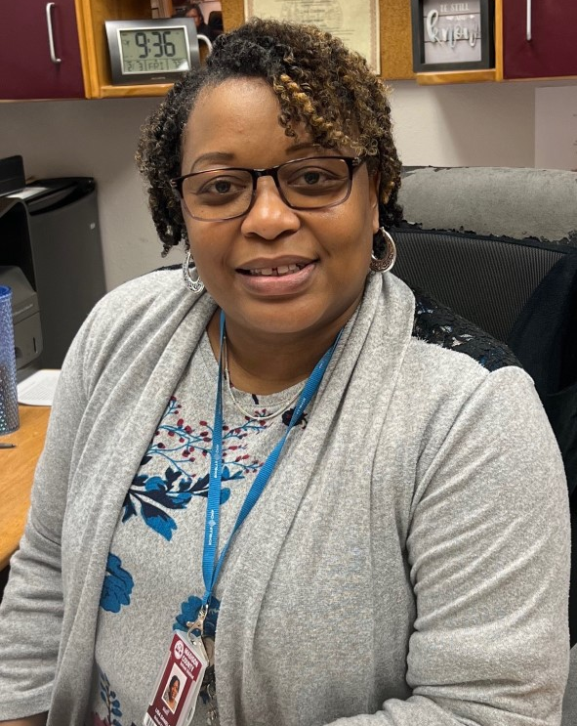
Ms. Lisa Daniels
Madison County Central School

Slide 5
Ms. Roshannon Powell
Greenville Elementary School

Slide 6
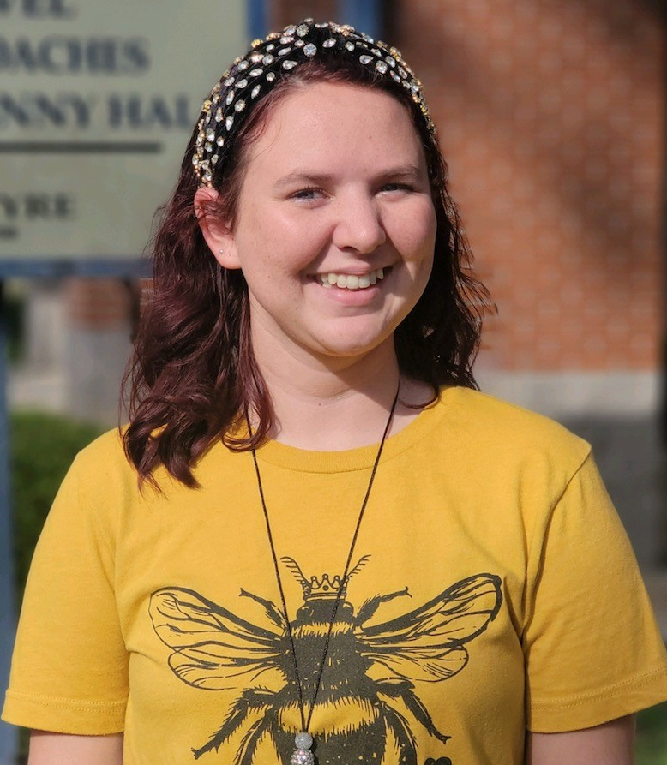
Ms. Brittany Greeson
Pinetta Elementary School

Slide 7
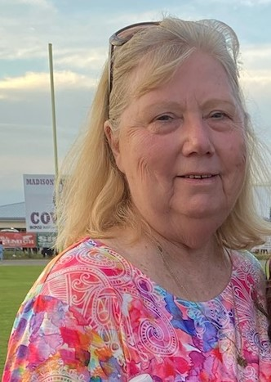
Ms. Evelyn Chancy
Madison County High School

Slide 8
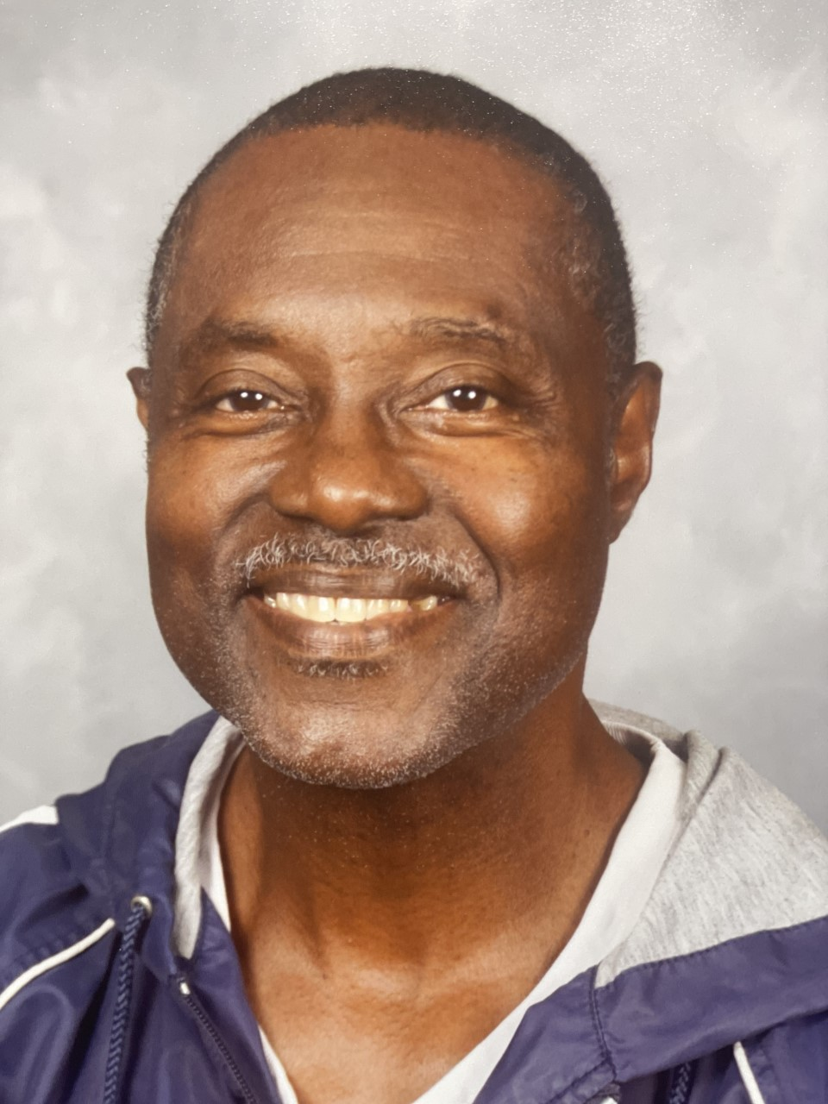
Mr. Freddie Williams
Lee Elementary School

Slide 9
Ms. Kayla Kinsey
Madison Creative Arts Academy

Slide 10
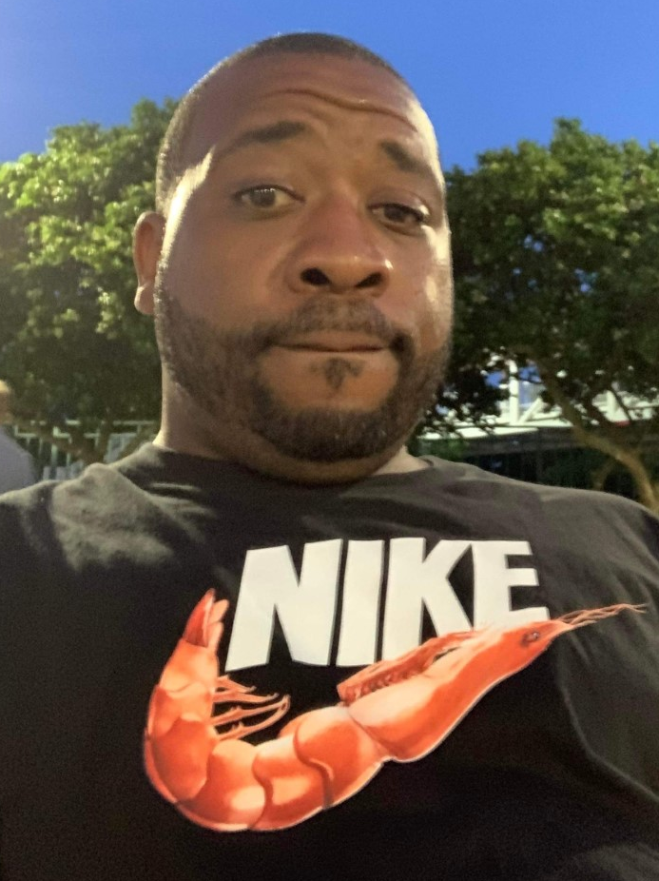
Mr. Morgan Scurry
James Madison Preparatory School

Slide 11
Recipient’s Name
Celebrating and Honoring our Support Personnel
ORGANIZATION NAME
Gratefully Acknowledges Sponsorship of
Item
By
Presenter’s Name and Title
February 6, 2023

